Slide 1



Salary of Data Science Jobs
Presenter
Jagdish Vishwakarma

Slide 2

About Data ?
Factors influencing the salary of Data Science Jobs
Work Year
Job Title
Employment Type
Company Location
Company Size

Slide 3
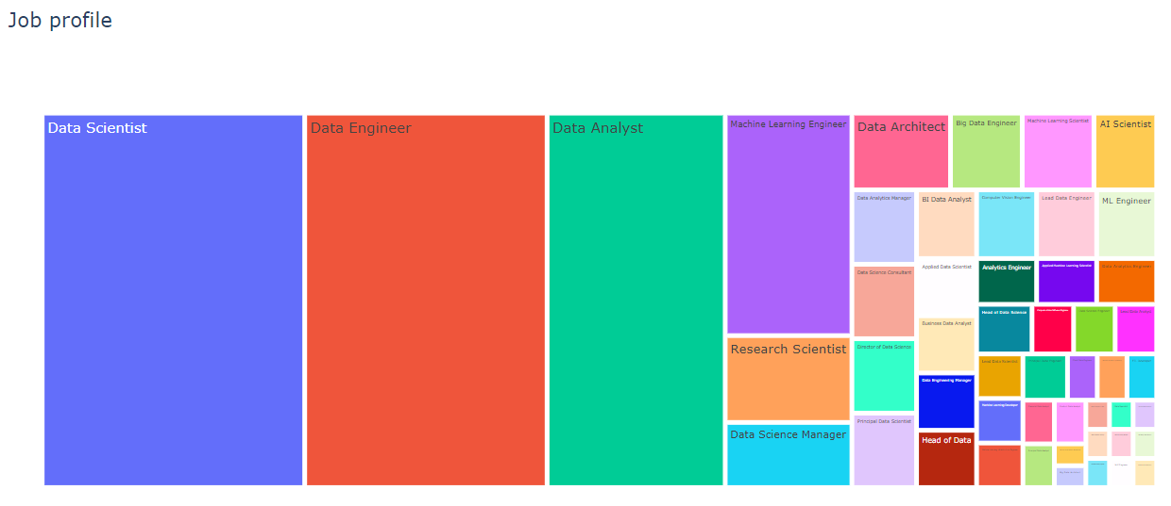
Tree Map of Job Profiles in Data Science Field :

Slide 4
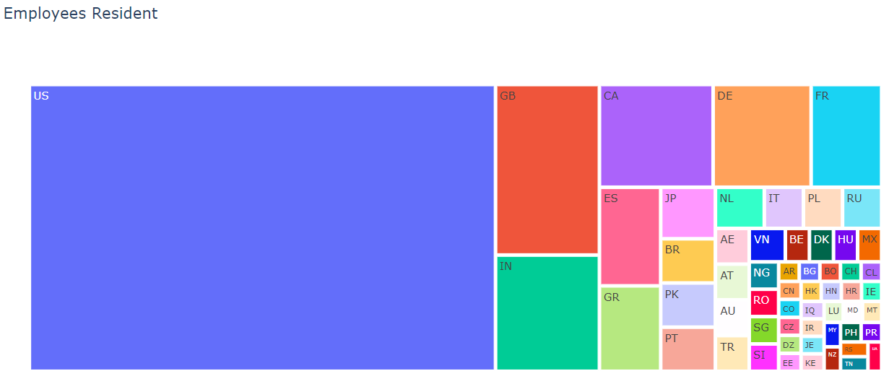
Tree Map of Data Science Employees Resident :
Great Britain
Canada
Germany
France
Maximum employees are from
UNITED STATES OF AMERICA
India

Slide 5
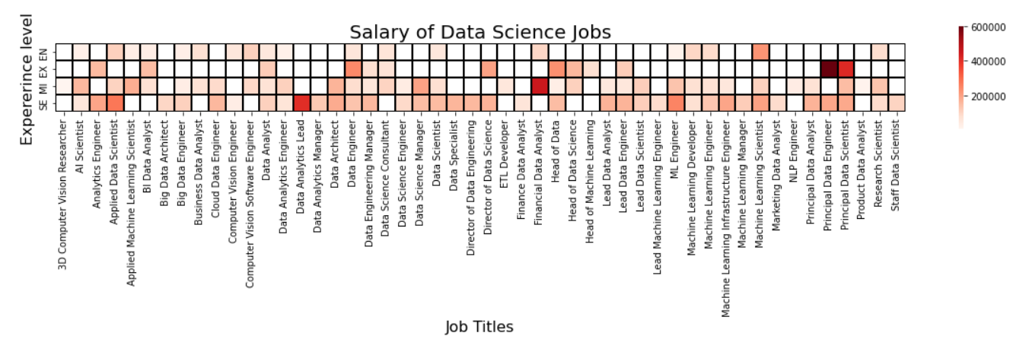
Salary based on Job Title and Experience level :
We can conclude that Senior Level employees are getting higher salary.

Slide 6
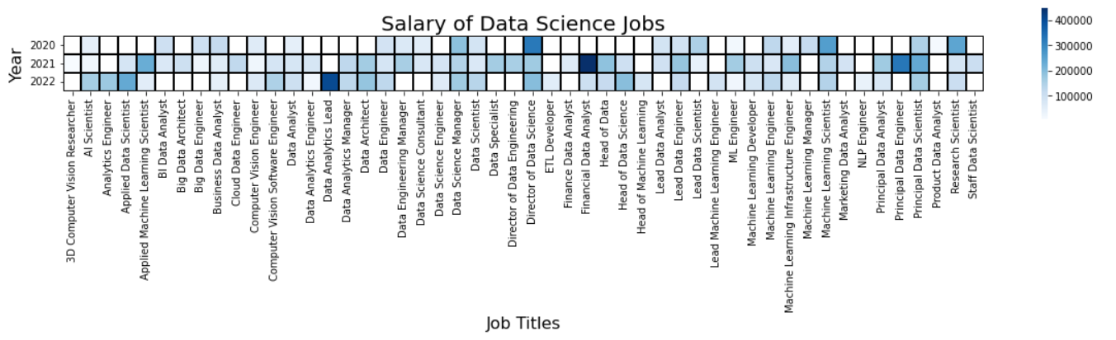
Salary based on Job Title and Work Year :
As compared to 2020 we can see people are getting paid more in year 2022. So, we can say that in coming years

Slide 7




Thank you
Jagdish Vishwakarma
jagdish21sept@gmail.com

Slide 8
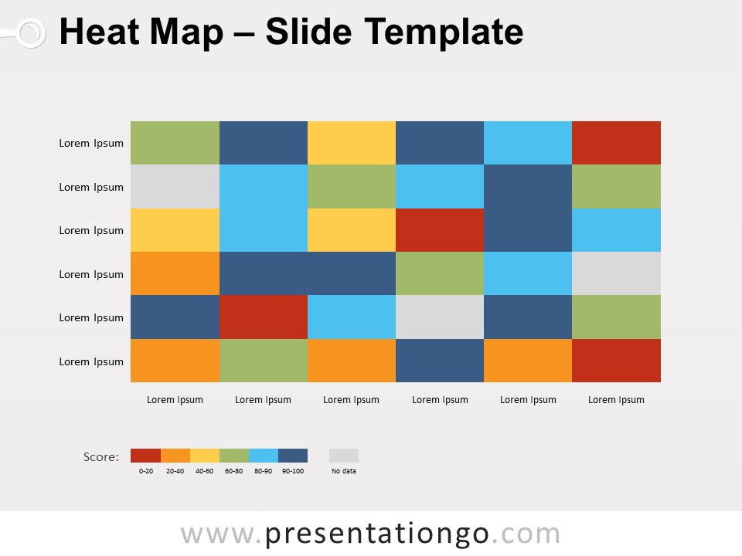
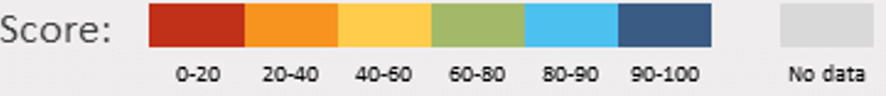
Heat Map Sample :
English
Maths
Science
History
Geography
Art and craft
Rahul Prashant Rushikesh Pooja Summit Jagdish
8

